Slide 1
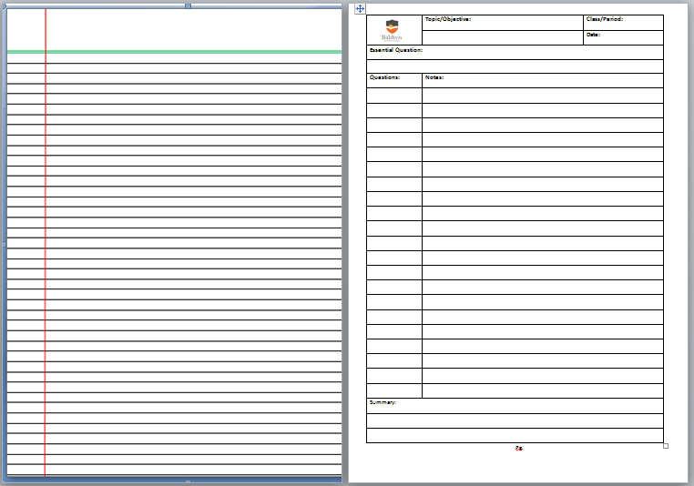
Rule up new page.

Slide 2
24
7
30
Date
Simultaneous equations – substitution method
EQ – How do I solve simultaneous equations using the substitution method?
If two (or more) equations have the same variables and the same solutions then they are simultaneous equations.
'Solving' simultaneous equations means finding the values of 'x' and 'y' that make them true. The following steps will demonstrate how to solve simultaneous equations by the substitution method.

Slide 3
24
7
30
Date
Simultaneous equations – substitution method
EQ – How do I solve simultaneous equations using the substitution method?
Solve the following:
x + y = 3 and
2x + 3y = 8
Step 1: Isolate one of the variables ( ‘x’ ) on one side of one of the equations:
x + y = 3 (-y)
x = 3 - y
(2) Substitute for the isolated variable in the other equation:
2x + 3y = 8 (Substituting 3 - y for ‘x’)
2(3 - y) + 3y = 8
This equation has only one variable, so we can solve it.

Slide 4
24
7
30
Date
Simultaneous equations – substitution method
EQ – How do I solve simultaneous equations using the substitution method?
Step 3: Solve this equation for the other variable, ‘y’:
2(3 - y) + 3y = 8 (Expanding the brackets)
6 - 2y + 3y = 8 (Simplify)
6 + y = 8 (-6)
y = 2
Step 4: Substitute the known value of ‘y’ into the equation for ‘x’ derived in step 1:
x = 3 - y (Substitute 2 for ‘y’)
x = 3 - 2
x = 1

Slide 5
24
7
30
Date
Simultaneous equations – substitution method
EQ – How do I solve simultaneous equations using the substitution method?
Solution: x = 1, y = 2
Check:
1 + 2 = 3 
2 × 1 + 3 × 2 = 8 

Slide 6
Questions: Exercise 2.7 page 24 Dwyer Book

Slide 7
Notes Review
24, 7 ,30
Date
Title
Essential question
Notes complete
Notes complete with colour and diagrams
Questions completed
Contents page filed in
Formula page filled in

Slide 8
Homework
Review your notes and write a summary answering the essential question.

